Slide 1


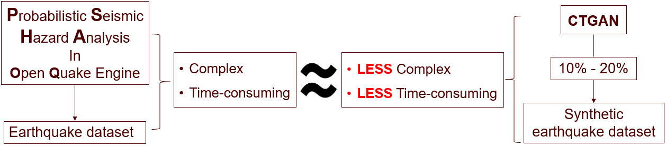
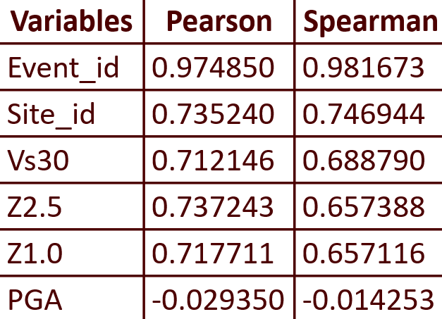
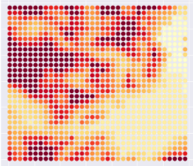
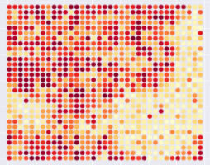
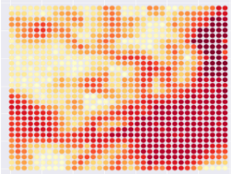
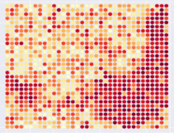
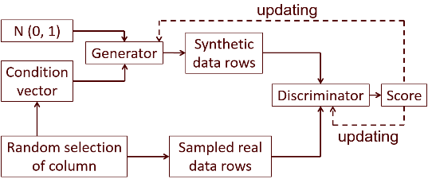
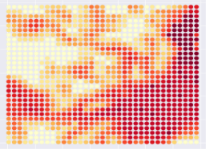
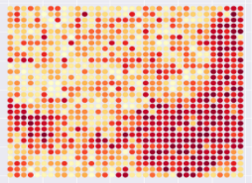
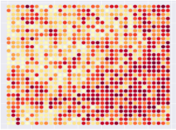
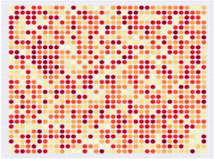
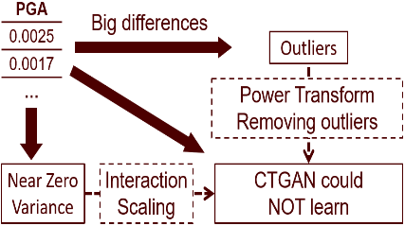
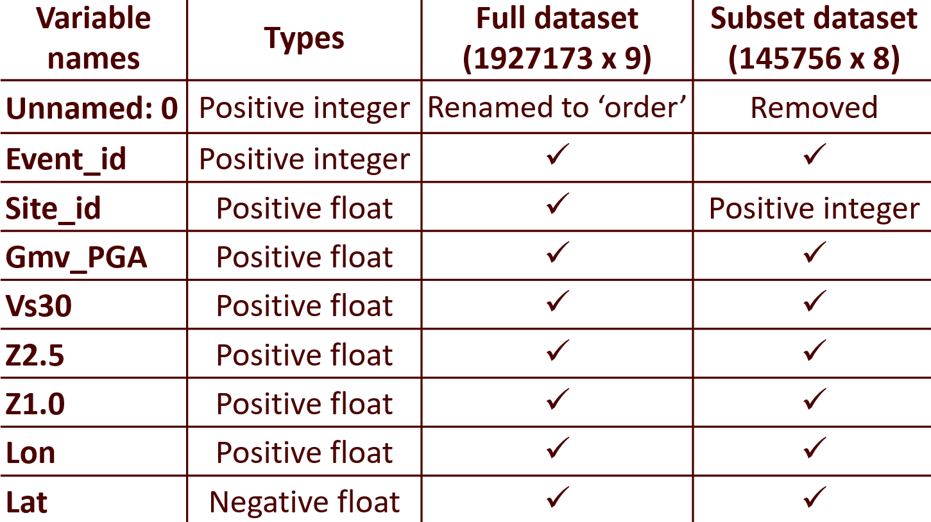
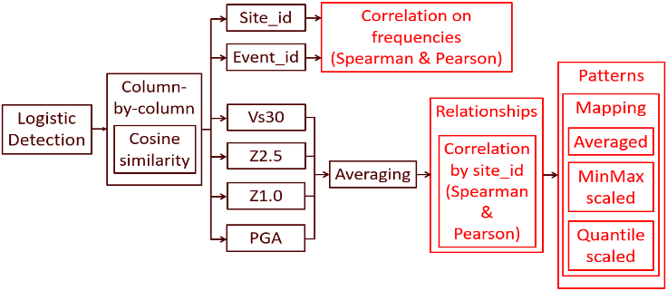
Applications of Generative Models to enhance the performance of complex Probabilistic Seismic Models
Students: Martin Nguyen
Jian Di
Supervisor: Phil Davies
GNS Science mentors: Dr. Robert Buxton
Dr. Alexandre Dunant
Project Overview
Data – Description
Results
The dataset contained the earthquake information occurred within the Hawke’s Bay area caused by the Hikurangi Subduction Zone.
Reduced the full dataset into a sub-dataset by changing the longitude and the latitude:
  -39.70 < latitude < -39.40
  176.55 < longitude < 177.90
The sub-dataset was used to generate a synthetic dataset. The similarity evaluation was processed on these two datasets.
Table 3. Correlation scores
DID LEARN WELL
DID NOT LEARN WELL
On event_id, site_id, Vs30, Z2.5, and Z1.0
On the size and types (positive integer and float) of the dataset
On features such as correlations between variables
On distributions
On the PGA. Not able to learn the accurate values of the variable which was almost zero.
On boundaries of the shape of an area with the longitude and the latitude
Figure 1. Project idea
Probabilistic Seismic Hazard Analysis (PSHA) was used in Open Quake (OQ) Engine to produce tabular data containing earthquake information.
The PSHA procedure was extremely complex and computationally time-consuming.
In the project, the Conditional Tabular Generative Adversarial Network (CTGAN) model was selected and tuned to learn the underlying earthquake features from a small sample (10% ~ 20%) of the tabular data to generate the synthetic dataset for reducing the complexity and the computation time. The performance of the CTGAN model was assessed by Logistic Detection, Cosine Similarity, Pearson’s and Spearman’s Correlation, and Mapping.
CTGAN
Map 1. Vs30 (left – real, right – ctgan)
Map 2. Z2.5 (left – real, right – ctgan)
Objectives
Figure 2. Training process of CTGAN
To identify any generative model that could learn the underlying features of the earthquake modelling processes.
To evaluate the similarity between the tabular containing earthquake information and the output generated by the identified model with the tuned hyperparameters.
The generator used the noise from Gaussian Mixture Model and Condition vector from the real dataset to generate synthetic data rows.
The discriminator distinguished the real and synthetic data rows by outputting a scalar score.
Both the generator and the discriminator were updated until the discriminator could not distinguish the difference of the score anymore.
Map 3. Z1.0 (left – real, right – ctgan)
Map 4. PGA (left – real, right – ctgan)
Data – Table
Problem
Discussion
Table 1. The full dataset and the sub-dataset
Objective 1: The CTGAN model from the ‘ctgan’ package version 0.2.2 can learn the underlying features of the earthquake modelling processes.
Objective 2: An evaluation system was developed to evaluate the similarity between two datasets. It included the Logistic Detection, the Cosine Similarity, the Correlation, and the Mapping methods.
Evaluation system
Figure 4. Problem explanation
Further research
Extended research: Trying the improved CTGAN model with other sub-datasets or the whole dataset; Trying other solutions for PGA problem such as updating the ‘ctgan’ package and developing a new model.
Other research: Further applications of generative models in other hazard analysis such as flooding and volcanic analyses.
Figure 3. Evaluation system

